Slide 1

Student Placement Predicter
Jared Ahenkora-Kwakyi

Slide 2
Introduction to Data
This dataset consists of placement data for students at an undisclosed university.
The data includes secondary and higher education percentages and specializations.
We also see degree specializations, the type, and work experience of each student.

Slide 3
The Question
The goal of my analysis was to determine which factors contributed to a student's placement.

Slide 4
Data Cleaning
The data that I decided not to include was the salary of placed students because that information was incumbent on whether the student got placed.
I made the serial numbers the index. It was an unneeded column alone, but I could use it as an index reference for each individual student.
I ordinal encoded two columns so they could be used with the algorithm; workex and placement status. Doing this allowed me to view the correlation between them and every other needed column on a heatmap.

Slide 5
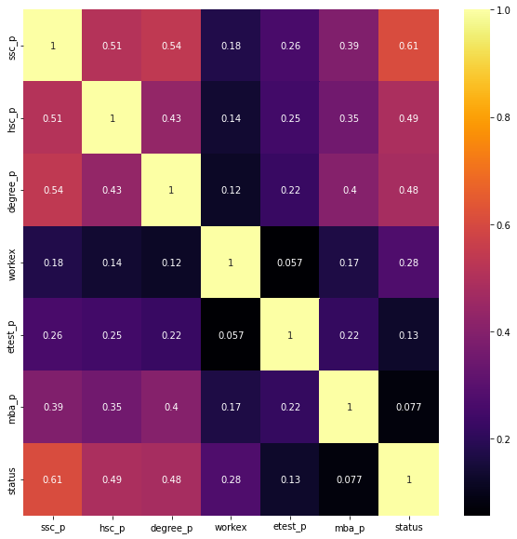
Heatmap
From this heatmap, We saw multiple strong correlations between specific columns and the placement status of a student.
Secondary Education percentage
Higher Secondary Education percentage
Degree Percentage
Work Experience had a smaller correlation, but It was enough for me to seriously consider it as a determining factor.

Slide 6
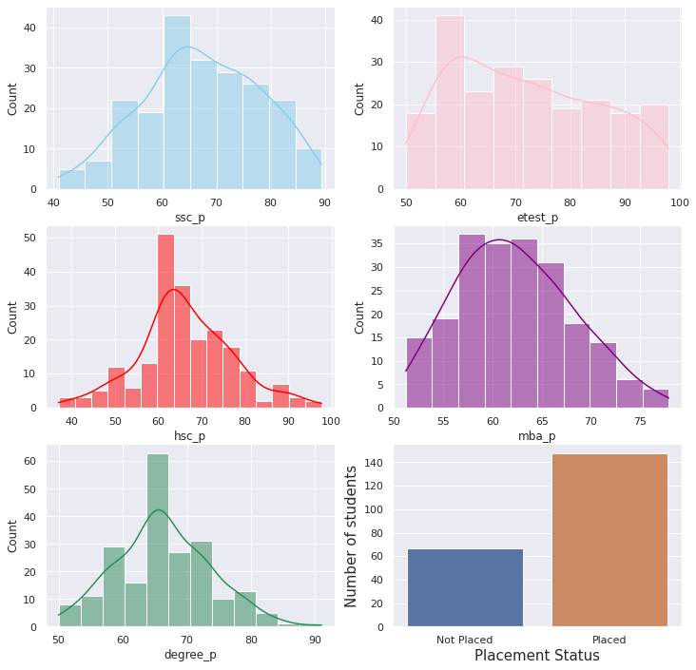
Histplots
This histplot was used to give me a quick understanding of where all the students fell in relation to different completion percentages for individual programs.
We also see a majorly unbalanced target are with a significantly higher number of placed students compared to those that weren’t placed.
We also see that a large majority of the students are midway through there degrees and education. What does this mean?
That told me that there was a combination of percentages that would lead to a student's placement. Not just if they completed a program vs. someone that did not.

Slide 7
Thank you

